Slide 1

Notes:
What's the last great TV show or movie you watched?
https://www.polleverywhere.com/free_text_polls/1bWcItYY3Lz5IwIaJ7JVA

Slide 2

Day 2: Visualization, Dimensionality Reduction and Manifold Learning
Notes:
TA introduction
Talk about not teaching code (not a programming workshop)

Slide 3
Thinking about high dimensional data
Notes:
TA introduction
Talk about not teaching code (not a programming workshop)

Slide 4
Our Data is a High-dimensional Matrix
variables
observations
gene1
gene2
gene3
Cell1
d11
d12
Cell2
d21
d22

Slide 5
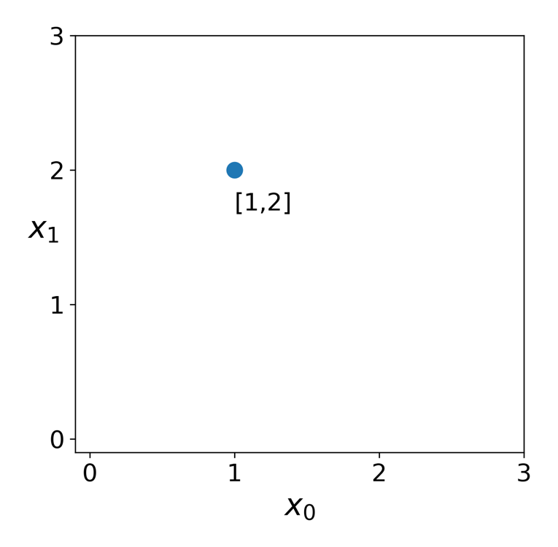
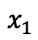
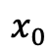
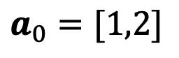
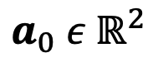
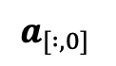
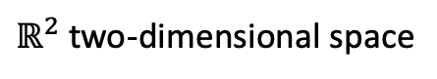
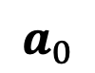
Features are dimensions
vector
coordinate space
$ℝ^{2}$ two-dimensional space
$$a_{0} ε{ ℝ}^{2}$$
$$a_{0}=[1,2]$$
$$a_{0}$$
$$x_{0}$$
$$x_{1}$$
features
$$a_{[ :,0]}$$

Slide 6
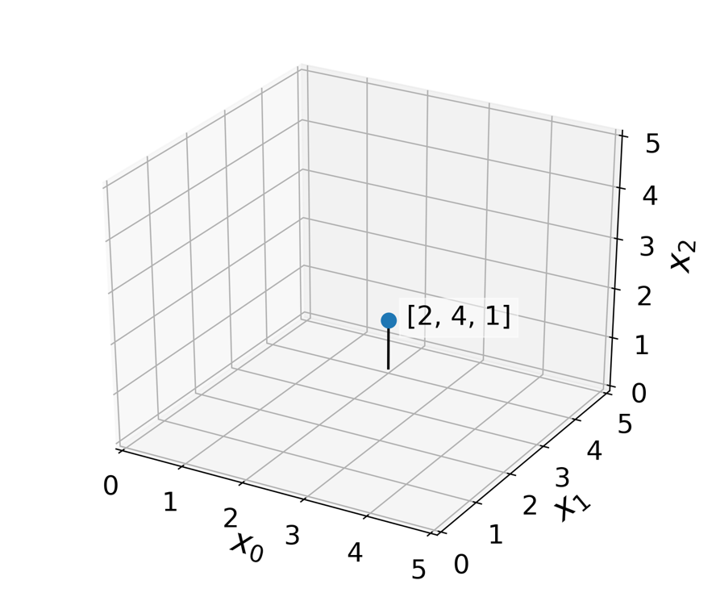
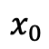
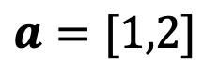
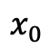
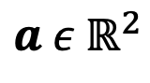
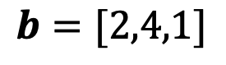
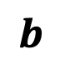
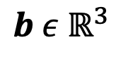
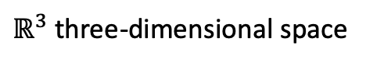
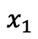
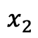
Features are dimensions
$$a ε{ ℝ}^{2}$$
$ℝ^{3}$ three-dimensional space
$$a=[1,2]$$
$$x_{0}$$
$$x_{1}$$
$$b ε{ ℝ}^{3}$$
$$b=[2,4,1]$$
$$b$$
$$x_{0}$$
$$x_{1}$$
$$x_{2}$$

Slide 7
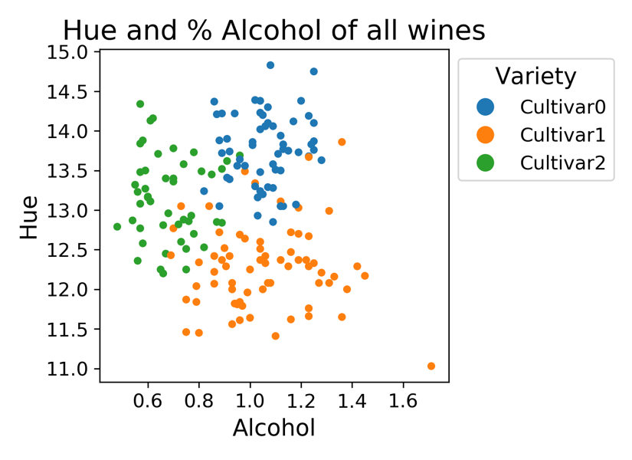
Features reveal structure
Feature 2
Feature 1

Slide 8
Many types of structure can exist in data
Feature 2
Feature 1

Slide 9
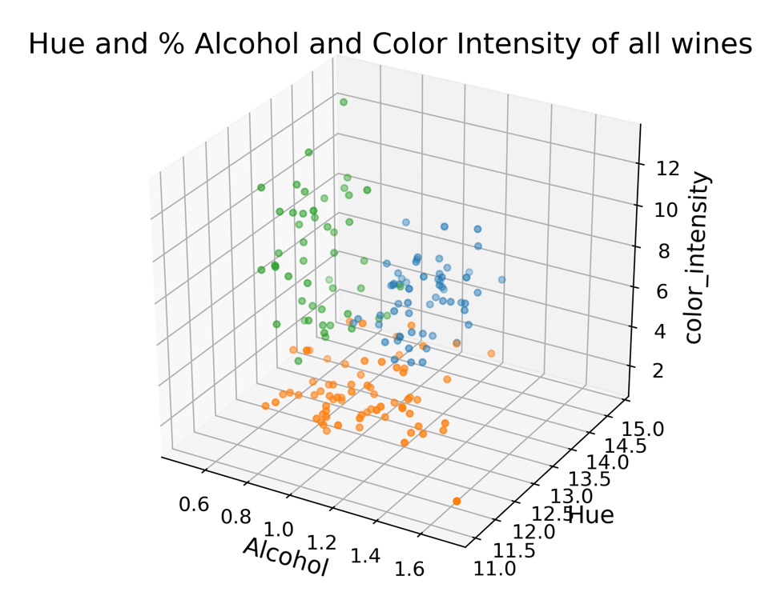
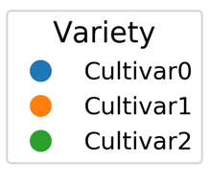
More Dimensions = More Accurate Structure

Slide 10
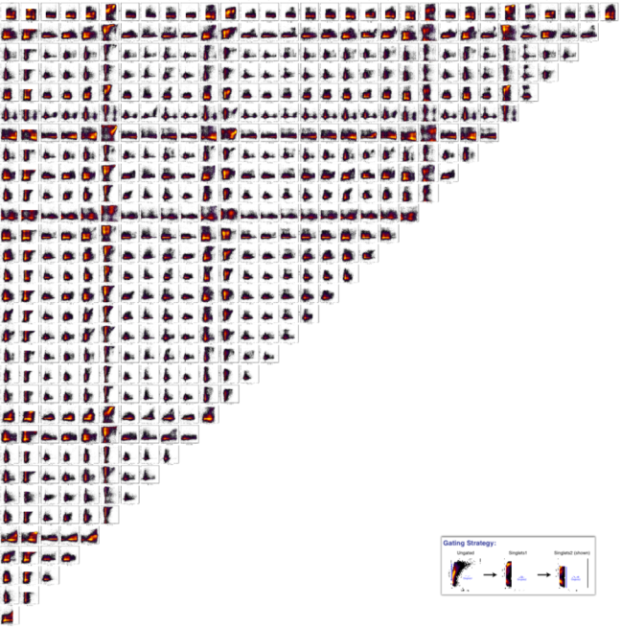
Problem: We can only see in 3D (not 20K D)
We could try all 2D pairs,
but our brains can’t put this
together
Notes:
Are the green and orange cultivars really different? How could we tell?

Slide 11
Solution: Dimensionality Reduction

Slide 12
Thought Exercise: Reduce this to 1D
Feature 2
Feature 1
Notes:
Are the green and orange cultivars really different? How could we tell?

Slide 13
Thought Exercise: Reduce this to 1D
Most distant points on top of each other !
Feature 2
Feature 1
Notes:
Are the green and orange cultivars really different? How could we tell?

Slide 14
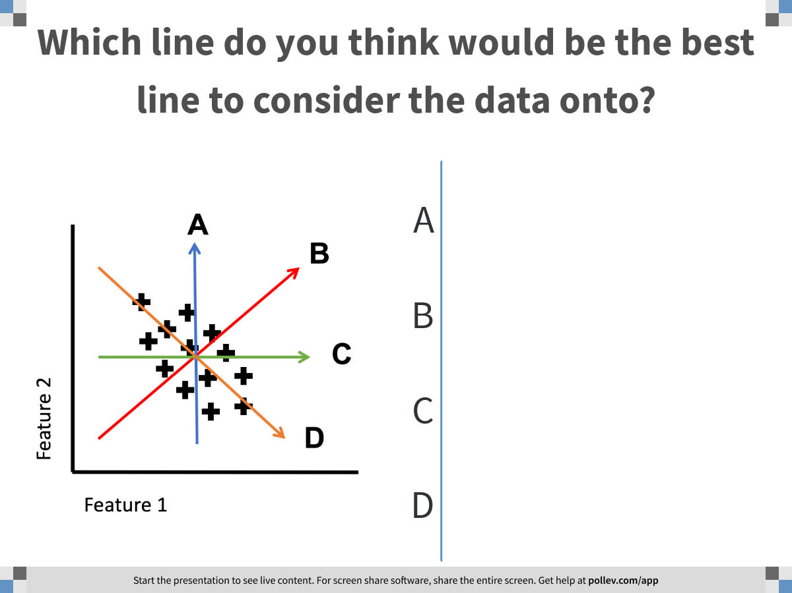
Notes:
Which line do you think would be the best line to consider the data onto?
https://www.polleverywhere.com/multiple_choice_polls/HAQR84GN9TY1YBStZDwh1

Slide 15
Thought Exercise: Reduce this to 1D
Feature 2
Feature 1
Notes:
Are the green and orange cultivars really different? How could we tell?

Slide 16
Thought Exercise: Reduce this to 1D
What is special about
this line?
It explains most of the variance in the data
Feature 2
Feature 1
Notes:
Are the green and orange cultivars really different? How could we tell?

Slide 17
Principal Components Analysis
PCA linear directions
in the data that explain
the most variance
PC1 explains the most
PC2 explains the next most
and is orthogonal to PC1
PC1
PC2
Feature 2
Feature 1
How do we find these directions?
Notes:
Are the green and orange cultivars really different? How could we tell?

Slide 18
Covariance Matrix

Slide 19
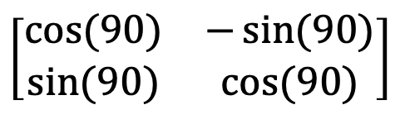
Matrices as Transformations
Matrices only store data, but can also represent transformations
Specifically they are linear transformations
They transform lines by changing their length and angle from origin
$$\left[\begin{matrix}cos⁡(90) & −\sin{(90)} \\ sin⁡(90) & cos⁡(90)\end{matrix}\right]$$
*
=
Rotation matrix
Line
Rotated
Line

Slide 20
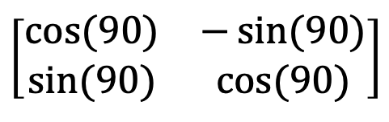
Matrix–Vector Notation
Lines can be described as vectors from the origin
(1,1)
1
Line
1
$$\left[\begin{matrix}cos⁡(90) & −\sin{(90)} \\ sin⁡(90) & cos⁡(90)\end{matrix}\right]$$
1
-1
=
1
1

Slide 21
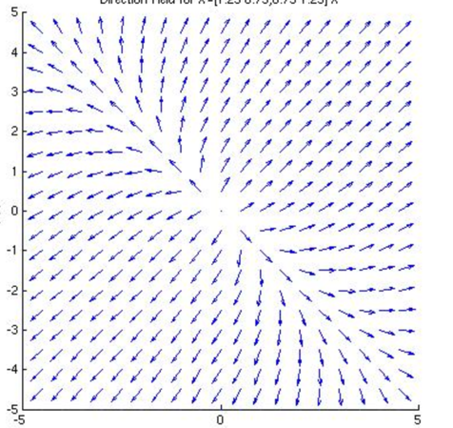
Eigenvectors
Rotation matrices rotate lines
in only one direction
Other matrices can move different lines in different directions
Such linear transformations have fixed points called Eigenvectors
In other words, the transformation only stretches the vector and does not rotate it.

Slide 22
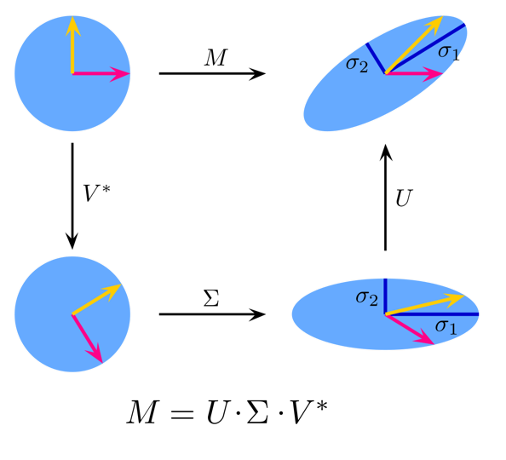
Eigendecomposition
Eigenvectors can be used to decompose a linear transformation into a rotation + stretch + anti-rotation
Non-square matrices
have similar OP called
Singular value decomposition

Slide 23
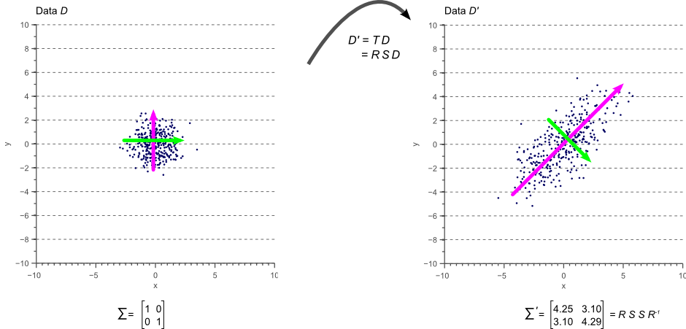
Eigenvectors of Covariance
Matrix creates correlation structure of data on unit blob

Slide 24
Principal Components Analysis
PC1 is first eigenvector (with
Highest eigenvalue)
PC2 is next eigenvector
PC1
PC2
Feature 2
Feature 1
Notes:
Are the green and orange cultivars really different? How could we tell?

Slide 25
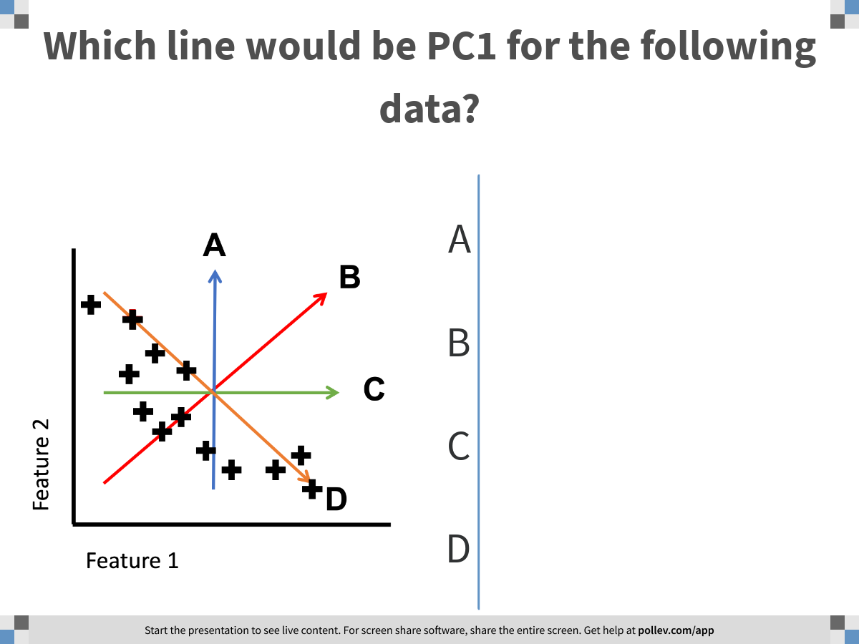
Notes:
Which line would be PC1 for the following data?
https://www.polleverywhere.com/multiple_choice_polls/XqXZHtwAyYj9nIw41hdOt

Slide 26
Quick quiz
Which line would be PC1 for the following data?
A
B
C
Feature 2
D
Feature 1

Slide 27
Non-linear structure
What if the data looked like this?
What line would be good
to project to here?
Feature 2
Feature 1
Notes:
Are the green and orange cultivars really different? How could we tell?

Slide 28
Non-linear dimensionality reduction
Notes:
TA introduction
Talk about not teaching code (not a programming workshop)

Slide 29
Non-linear dimensions
To find non-linear or “coiled” dimensions in a dataset we have to understand, and describe the shape of the data
The data can live in lower dimensions
This can be abstractly called the data “manifold”
Feature 2
Feature 1
Notes:
Mention that the “manifold dimensionality” of this manifold is 2d

Slide 30
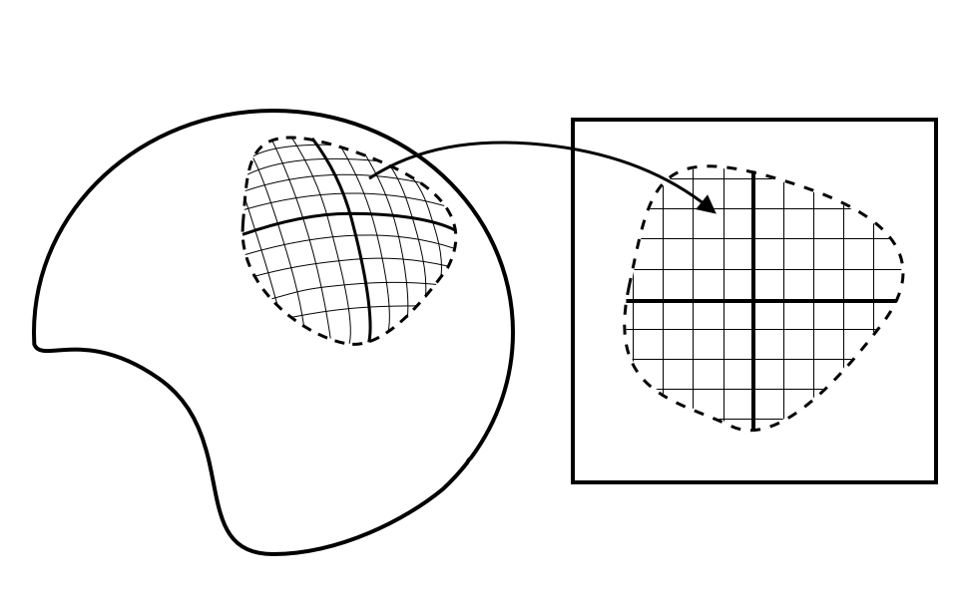
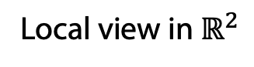
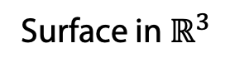
What is a manifold?
Surface in $ℝ^{3}$
Local view in $ℝ^{2}$
Locally smooth
Locally Euclidean
Generally, lower dimensional than the ambient space (i.e. a subspace)
Notes:
Mention that the “manifold dimensionality” of this manifold is 2d

Slide 31
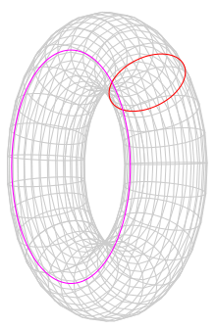
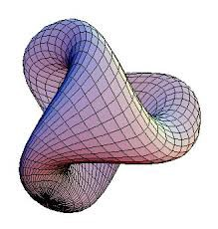
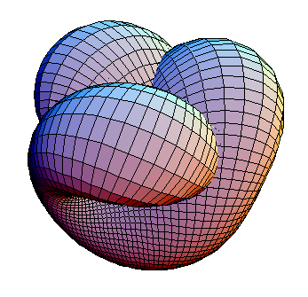
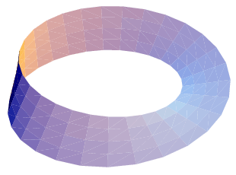
Examples of manifolds
Wolfram
Notes:
Mention that the “manifold dimensionality” of this manifold is 2d

Slide 32
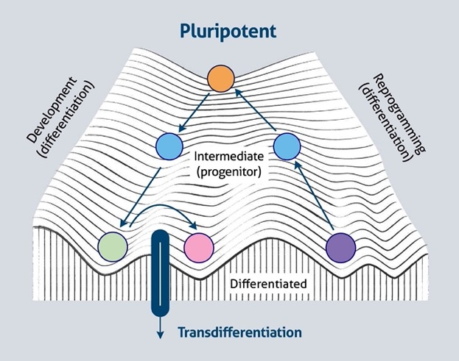
Examples of manifolds
Waddington’s landscape
Wolfram
ptglab.com
Notes:
Mention that the “manifold dimensionality” of this manifold is 2d

Slide 33
Examples of manifolds
Waddington’s landscape
Smooth transitions between states
Small changes in gene expression are linear
Wolfram
ptglab.com
Notes:
Mention that the “manifold dimensionality” of this manifold is 2d

Slide 34
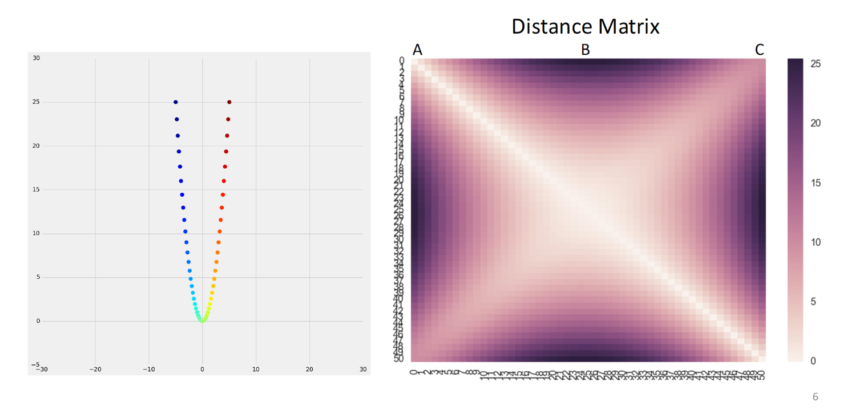
Kernel functions measure “similarity” or “affinity” on a graph

Slide 35
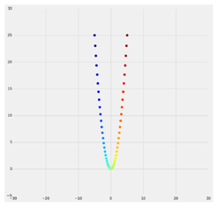
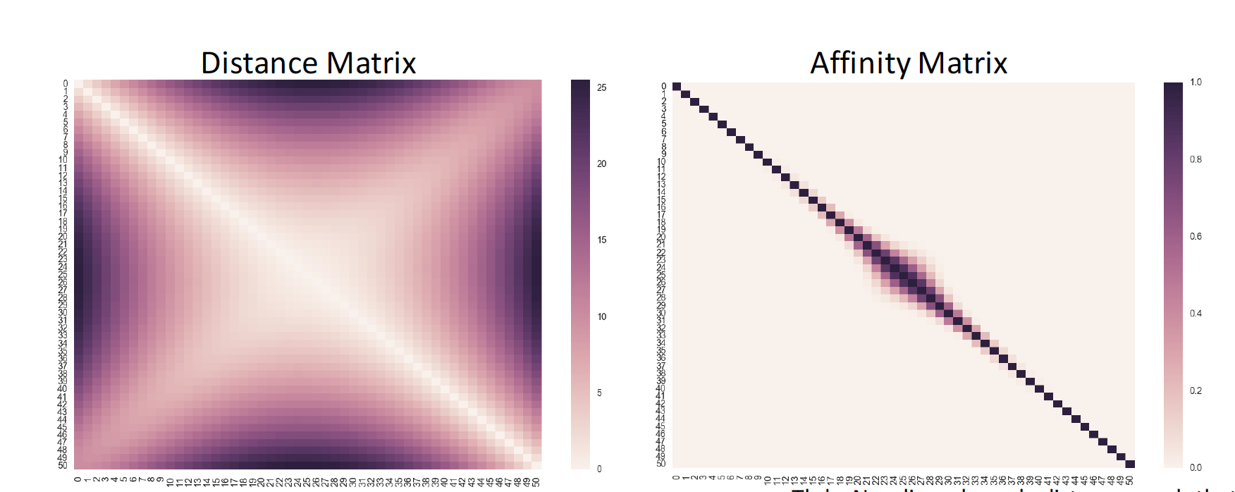
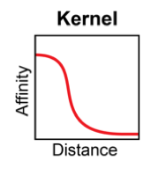
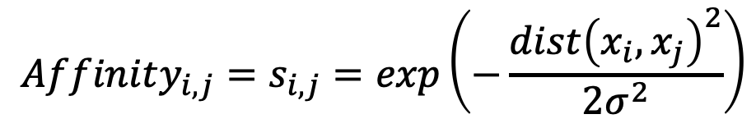
Affinity is the inverse of distance + locality
$$Affinity_{i,j}=s_{i,j}=exp\left(−\frac{dist{\left(x_{i}, x_{j}\right)}^{2}}{2σ^{2}}\right)$$

Slide 36
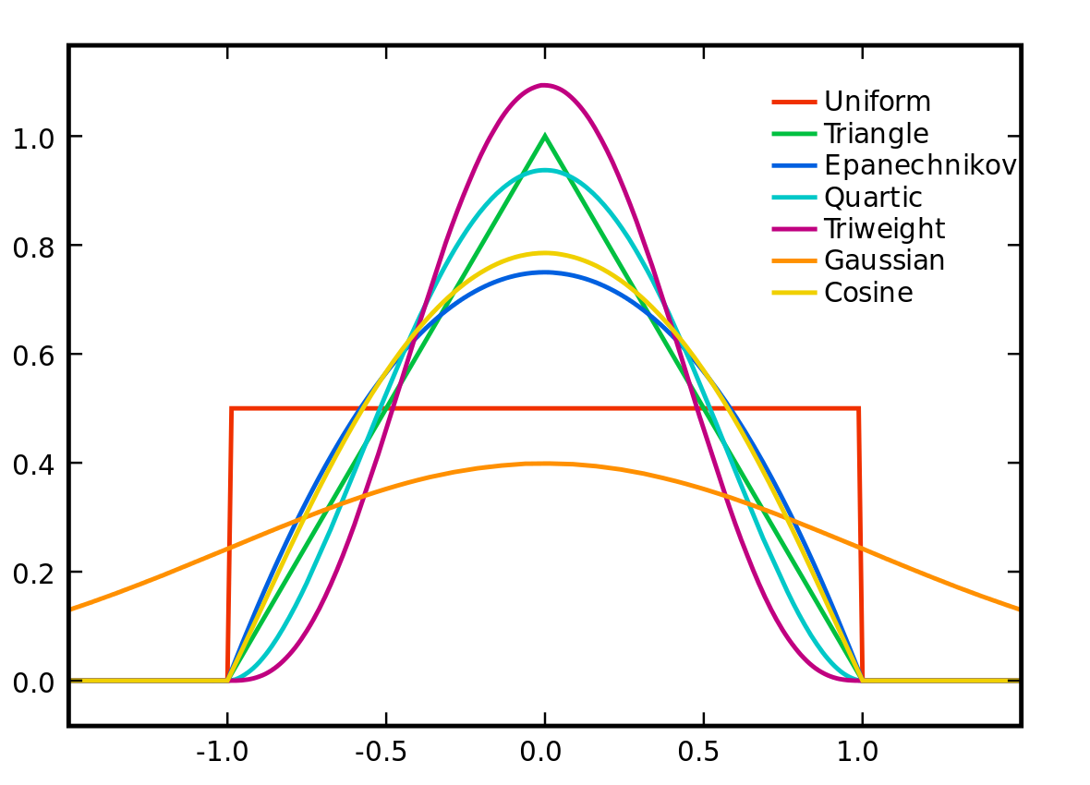
Distance to Affinity via Kernels
Real-valued
Non-negative
Symmetric
Affinities correlations in this hidden hypothetical space

Slide 37
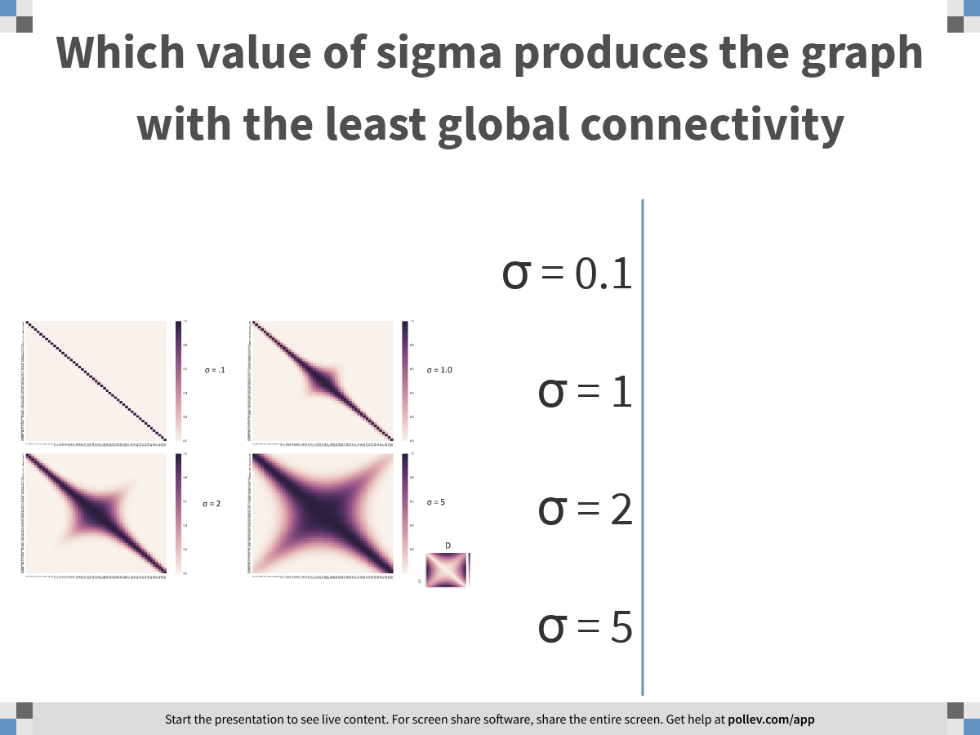
Notes:
Which value of sigma produces the graph with the least global connectivity
https://www.polleverywhere.com/multiple_choice_polls/zTr7Kdvryx4DGwa6xKRK1

Slide 38
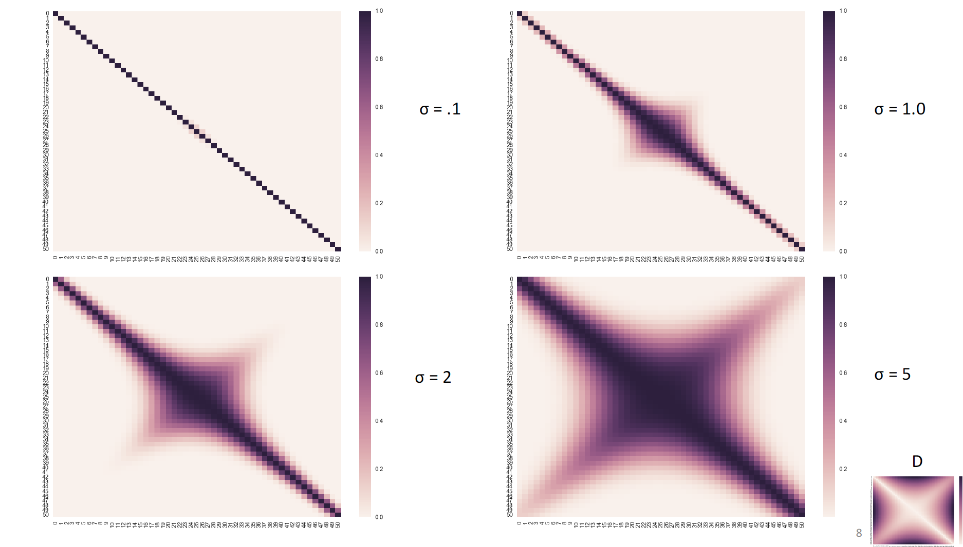
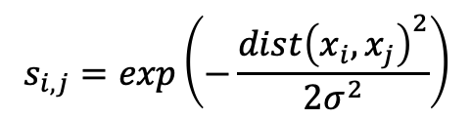
Effect of Changing Kernel Width
$$s_{i,j}=exp\left(−\frac{dist{\left(x_{i}, x_{j}\right)}^{2}}{2σ^{2}}\right)$$

Slide 39
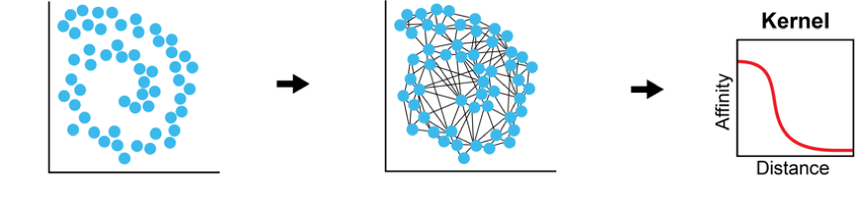
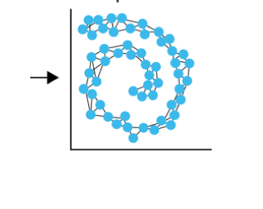
Kernel PCA
data
distances
Affiniities
Use eigenvectors of an affinity matrix instead of covariance matrix
The family of methods called kernel PCA:
Specific variants include:
Laplacian Eigenmaps
Diffusion Maps

Slide 40
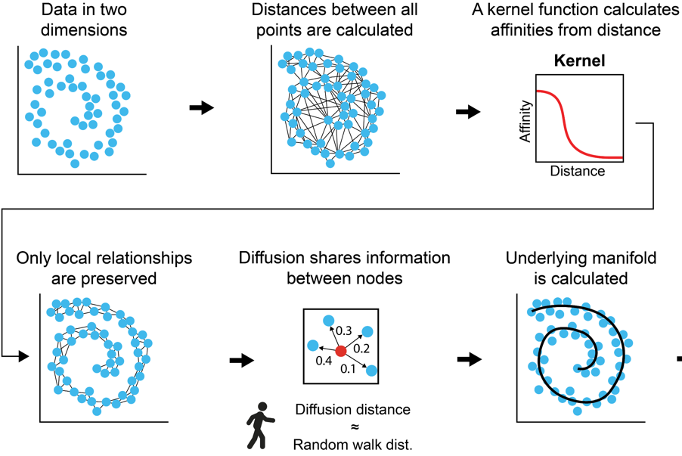
Diffusion Maps
Data in high
dimensions
Eigendecomposition gives principal axes of manifold structure

Slide 41


Distance Matrix
Entries are distances
$$D\left(x_{i},x_{j}\right)=\sqrt{||x_{i}−x_{j}}||$$

Slide 42


Affinity Matrix
(Gaussian Kernel)
Graph Representation
Entries are affinities
$A\left(x_{i},x_{j}\right)=exp⁡(− \frac{{D(x_{i},x_{j})}^{2}}{σ}$)

Slide 43


Powered Markov Matrix
Powered Markov Matrix
Entries are row normalized affinities
M$\left(x_{i},x_{j}\right)$=$\frac{A\left(x_{i},x_{j}\right) }{\sum_{j}{A\left(x_{i},x_{j}\right) }}$

Slide 44


Powering or “walks” on data graphs reveal dominant data manifold directions
Shortest path between points
$$a_{1}$$
$$a_{1}$$
$$a_{2}$$
$$a_{2}$$

Slide 45


Paths or “walks” on graphs reveal dominant data manifold directions
$$a_{1}$$
P=1
$$a_{2}$$

Slide 46

Paths or “walks” on graphs reveal dominant data manifold directions
$$a_{1}$$
$$P=\frac{1}{4}$$
.25
.25
.25
$$a_{2}$$

Slide 47

Paths or “walks” on graphs reveal dominant data manifold directions
$$a_{1}$$
.2
.2
.2
.2
.2
$$a_{2}$$

Slide 48

Paths or “walks” on graphs reveal dominant data manifold directions
$$a_{1}$$
.25
.25
.25
.25
$$a_{2}$$

Slide 49

Paths or “walks” on graphs reveal dominant data manifold directions
$$a_{1}$$
$$a_{2}$$
Steps = 5

Slide 50

$$a_{1}$$
$$a_{3}$$
$$a_{2}$$

Slide 51
$$a_{1}$$
$$a_{1}$$
$$a_{3}$$
$$a_{2}$$
$$a_{2}$$
$$a_{3}$$

Slide 52
$$a_{1}$$
.9
$$a_{1}$$
.1
$$a_{3}$$
$$a_{2}$$
$$a_{2}$$
$$a_{3}$$

Slide 53

Eigendecomposition of Diffusion Operator = DMs
[Coifman, Lafon, ACHA 2006]

Slide 54


Uncoiling the space
First non-trivial eigenvector DM1 tracks the most prominent non-linear path

Slide 55


Lips Dataset: Spoken Digits
ONE

Slide 56

Lips Manifold
Opening of mouth
portion of teeth
visible

Slide 57

Diffusion components orthogonal

Slide 58

The graph Laplacian is a matrix representation of a graph
G
A adjacency matrix
D degree matrix
1
1
2
4
2
3
2
1
2
5
Laplacian matrix

Slide 59
Laplacian Eigenmaps
Eigenvectors of Laplacian matrix form Laplacian
Eigenmaps

Slide 60
Graph Laplacian
A difference operator based on the graph adjacency matrix A.
(unnormalized Laplacian)$L=D−A$
Degree matrix: $D_{ii}=\sum_{j}{A_{ij}}$ , 0 everywhere else
(normalized Laplacian) $L=I−D^{−1/2}{AD}^{−1/2}$
$I$ is identity
Measures how similar a point is to its neighbors
(random walk Laplacian) $L=I−D^{−1}A=I−M$
Related to Markovian matrix

Slide 61


Eigenvectors form a Graph Spectrum

Slide 62





Eigenvectors are frequency harmonics
2nd Eigenvector
10th Eigenvector
2nd to last eigenvector

Slide 63
For visualization
These methods preserve information from an affinity matrix in 2-3 dimensions exactly
There are as many eigenvectors as datapoints, so taking only the top 2 misses information
tSNE/UMAP: greedy method for preserving near neighbors in 2D
PHATE: creates a new distance matrix from a distance between diffusion probabilities of points and squeezes that variation into 2D

Slide 64


tSNE
Goal: Maintain the local neighborhood of each cell
Steps: 1. Place points randomly in a 2D plane
2. Move points to locally optimal location via gradient descent

Slide 65

tSNE Penalty
Neighbors in high dimensions
Neighbors in low dimensions
What happens when the p_{ij} is SMALL?
No effective penalty for placement of points that are not close

Slide 66
Combination of attraction and repulsion
Neighbors in high dimensions
High probabilities to some neighbors have to be counteracted by some low probabilities to other points (sum has to be 1)
To fit close neighbors together have to repel far points. This is what leads to a “explosion”-like embedding

Slide 67
UMAP
Very similar to tSNE (but its NOT published!)
What about the “uniform manifold approximation?”
This is actually saying that UMAP approximates a uniform manifold from your data
In other words tSNE/UMAP plots have even density throughout
Why uniform density?
They use a Markov matrix where the bandwidth is set to the Kth nearest neighbor, so each point is placed near its K-nearest neighbors no matter how near or far they are
Advantage of this is that you can see how many points are in each cluster
Disadvantage is you don’t get an idea of the real (even local) density

Slide 68

Local density inducing variant
http://cb.csail.mit.edu/cb/densvis/

Slide 69


Differences from tSNE
Initialized with a Laplacian eigenmap, stronger start to a greedy method
Noise-contrastive estimation in the implementation
UMAP uses an un-normalized matrix (probabilities don’t sum to 1)
Instead some points are sampled and if they are far away they have to be repelled
All nearest neighbors have to be put close
This decreases the repulsion
Less “explosive looking”
tSNE
UMAP

Slide 70

PHATE:
Goal: to preserve manifold structure
Step 1. Each cell is represented as a t-step diffusion probability to other cells
Diffusion induces global connectivity and denoises paths
PHATE uses an adaptive Markov matrix too! But using it for diffusion is very different from using it to match neighbors directly

Slide 71


Diffusion in PHATE denoises
Connectivity
without diffusion
Connectivity after
t-steps of diffusion

Slide 72
Adaptive Alpha-decay kernel
Adaptive kernel in PHATE separate geometry from density
If there are density variations in the initial Markov matrix creation then paths tend to drift towards dense regions and it DISTORTS geometry
Adaptive kernel (bandwidth set to Kth nearest neighbor) reveals geometry

Slide 73
PHATE:
Goal: to preserve manifold structure
Step 1. Each cell is represented as a t-step diffusion probability to other cells
Step 2: Re-represent each point by its diffusion probabilities to all other points
C₁ = [ p₁₁ p₁₂ …….p_{1n}]
C₂ = [ p₂₁ p₂₂ …….p_{2n}]
…
C_{n} = [ p_{n1} p_{n2} …….p_{nn}]

Slide 74


Step 3. Define a new distance between points with this new representation
Step 4: Embed with multidimensional scaling
This reorganizes information in a diffusion map into 2D
C₁ = [ p₁₁ p₁₂ …….p_{1n}]
……
C_{i} = [ p_{i1} p_{i2} …….p_{in}]
…
C_{j} = [ p_{j1} p_{j2} …….p_{jn}]
…
C_{n} = [ p_{n1} p_{n2} …….p_{nn}]

Slide 75


Adaptive vs fixed bandwidth kernel
Adaptive
Fixed

Slide 76


Comparing Artificial Case

Slide 77

Comparing visualization algorithms on single-cell data

Slide 78


Slide 79

Data agnostic: Neural network loss landscapes
PHATE
tSNE
UMAP
PCA
[Horoi et al. 2020]

Slide 80

Quantative Comparisons

Slide 81

DeMAP

Slide 82

I’m certain its a triangle
It’s a string network!
It’s a conic section
Look, a Fibonacci sequence!
Wikimedia Commons

Slide 83
Conclusions
Dimensionality reduction and visualization helps to identify structure in data
PCA uses eigenvectors to identify linear combinations of features that explain maximum variance
Manifold learning identifies non-linear patterns and structure
Graphs can be used to approximate manifolds and are helpful for modelling single cell data
Laplacian Eigenmaps and diffusion maps visualize data using dominant non-linear directions in data manifold
PHATE summarizes manifold information in 2D
UMAP, tSNE are non-linear methods focused on preserving local neighborhoods in 2D

Slide 84

Notes:
What questions do you have about today's lecture material?
https://www.polleverywhere.com/discourses/LcQaImIZ1dSuKR2Ww4pqu

